Slide 1
SDP Project
Bidding management system

Slide 2
Bidding system
At first we have to know what is meant by bidding.?
Bidding in the sense for example if any product which is to be sold for highest price it can be done by using bidding system by using this one can get profits..
Bidding means a group of people gather together either it may be online or offline and they can increase the selling price of the product according to it’s capability and it’s uses.

Slide 3
Development of Bidding Management System
Online Auction management system is a web based application which will assist clients with buying or selling items; they can sell anything they want by posting advertisements.
This application will enable clients to post their items for auction; bidders can create an account and are able to bid for any available product
There are some current applications that offer clients to bid on products but these aren’t available in the local area
Which is a disadvantage because you are unable to look at the product before you buy. With this Online Auction application clients will be able to bid for products that are available in their local area.

Slide 4
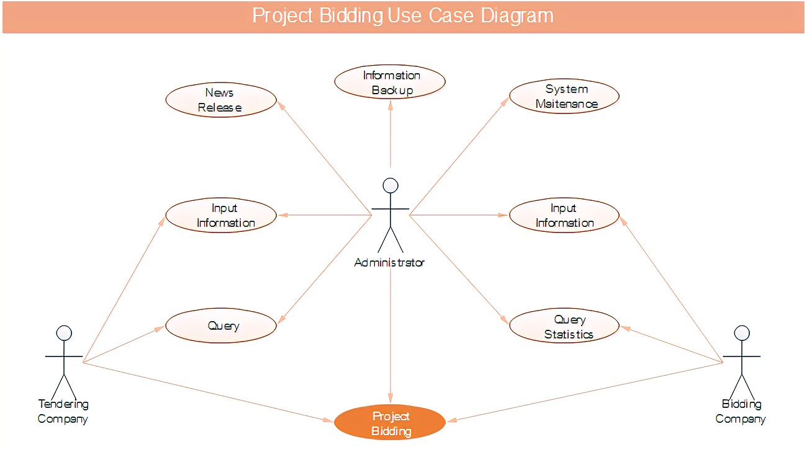
USE CASE DIAGRAM

Slide 5
Aim and Objectives
Aims:
The overall aim of the project is to create and develop a web application for buying and selling over the internet for university students. This will be done by creating an online auction system with ASP.net and MySQL.
To achieve the above aim, the following objectives will be carried out:
Create a user-friendly web application
Create a database where user’s information is stored
Research existing Online auction businesses
Implement security measures

Slide 6
Objectives
Objective 1 – Create a user-friendly web application
Objective 2 – Create a database where user’s information is stored

Slide 7
User stories
Are you looking for a Bidding management system project? We are here to help you. You can contact us. The Indian Premier League (IPL, officially Vivo Indian Premier League for sponsorship reasons) is a professional Twenty20 cricket league in India contested during April and May of every year by teams representing Indian cities.
The league was founded by the Board of Control for Cricket in India (BCCI). The IPL is the most attended cricket league in the world and ranks sixth among all sports leagues. Before the start of every season, players are auctioned for teams. Currently, this system is not fully computerized. So, we are trying to develop a fully computerized Bidding system for the next IPL season.
This system would be a fully cloud-based system. Bidders can bid on players from their offices, homes, or place where they want to be. This system would be more transparent anyone can view the IPL auction. But only registered team owners can bid on registered players. The system would be more available for bid 24X7 when online bidding of IPL going on.

Slide 8
Modules
Modules of Bidding Management System:
There are several modules required to complete this system. Here we are discussing the main modules or core modules of the system.
Admin Profile:
Admin profile is profiled which is assigned to a superuser having full access to the system. Admin module contains Admin Id, name, address, contact no. Admin can view player details, team owner details, bidding process, etc.
Player Profile:
Registered player details would be available for view. Player details would include player name, age, record, base price, etc. Once any player goes in the auction. A team owner can bid on him. The player would ably see the details of the owner who has won the bid. The player would also receive payment and bond to signed.

Slide 9
continues
Team Owner:
The team owner is someone who holds the maximum share of the team. A team owner can manage his/her team. Bid on a new player to join the team squad.
Search Player Details:
A team owner can search the details of each player. Sort them, add them to the cart, bid on them. Once they won the bid, they need to make payment to the player.
Availability:
A team owner can check whether a player is available for bid or not. If a player is available for bid and the player has not been sold. They wish to bid on a player they can.
Bidding:
The bidding process is a real-time process. Data in the database would be updated in real-time and visible to users in real-time.

Slide 10
User stories
Payment Details:
After successful winning of bid Team owners needs to pay the money using cash/net banking/ATM card. The payment portal would use a payment gateway to clear payment. Once payment will clear receipt of payment will be generated automatically. Add/update/delete Player’s Details. Only the admin can add, update, and delete the player’s details and others user details. Admin has special permission to do so.
User authentication according to his/her role:
The system is strong enough to make authentication as per logged in user.
Add Team Owners:
Admin can add team owner details, update owner’s budget. Team owner needs validate their profile before going in the bidding process.
System Design of Bidding Management System:
The system basically needs very simple architecture. This is system is there main three users i.e. Admin, Player, And owners.

